Slide 1

lightform.org.uk
Using MTEX in crystal plasticity modelling
Adam Plowman
adam.plowman@manchester.ac.uk
MTEX Workshop 2021

Slide 2

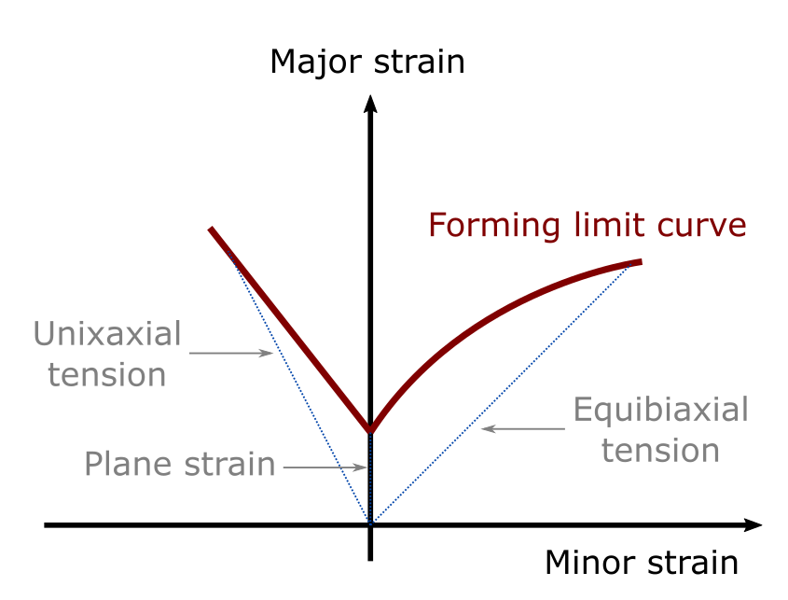
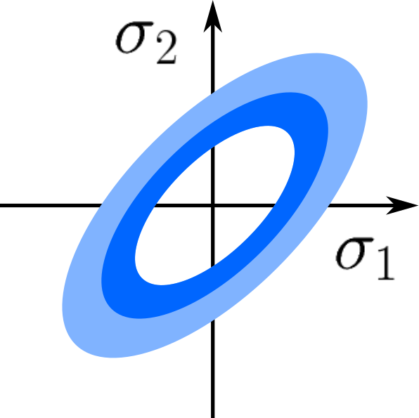
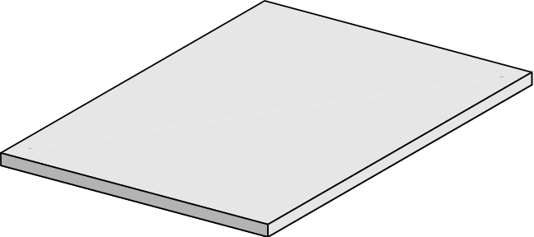
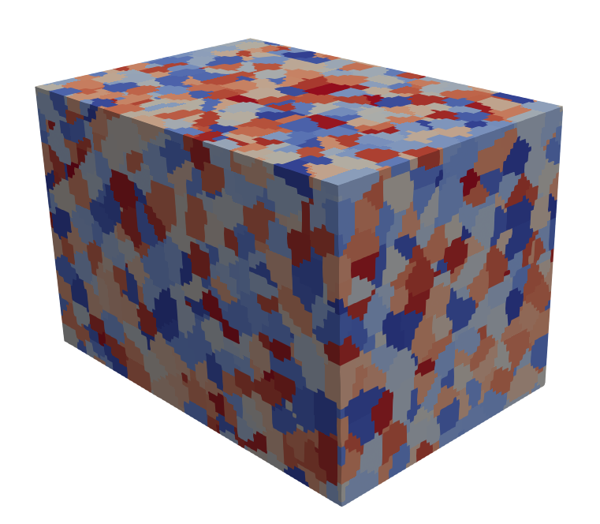
Background
Formability
Mechanical testing
Crystal plasticity
Representative volume element (RVE)
Yield surface
(stress states at yielding)
Forming limit diagram (FLD)
(strain states at onset of necking)
…but how sophisticated does our model need to be?
Experimental formability predictions:
Yield surface via mechanical testing in different directions
Forming limit diagram, via punch tests
Anisotropic yield surfaces may require large fitting dataset; complex/expensive experiments
Use a computer instead: virtual materials testing!
Yield surface provides input to component-scale simulations for FLD

Slide 3
Background
The MatFlow computational framework
We have developed an open-source (Python) framework for computational materials science
Users specify some tasks to run in a workflow (YAML file)
Tasks are specified according to: scientific objective, method and software
Main output is a workflow HDF5 file
Aims are:
Making reproducibility and transparency require less effort (can cite the HDF5 file in your paper)
Connecting disparate software via extensions (proprietary and open-source, like MTEX!)
Making comparisons easier (the same scientific objective can often be achieved in distinct ways)

Slide 4
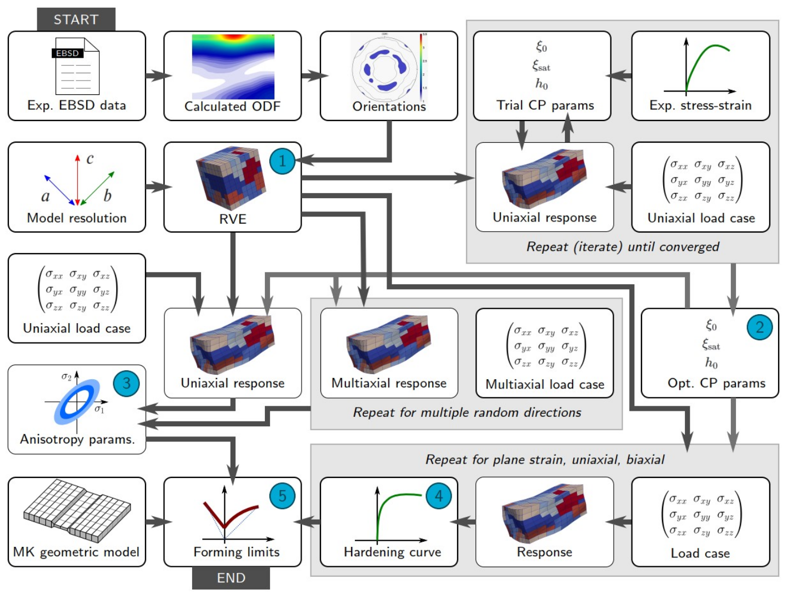
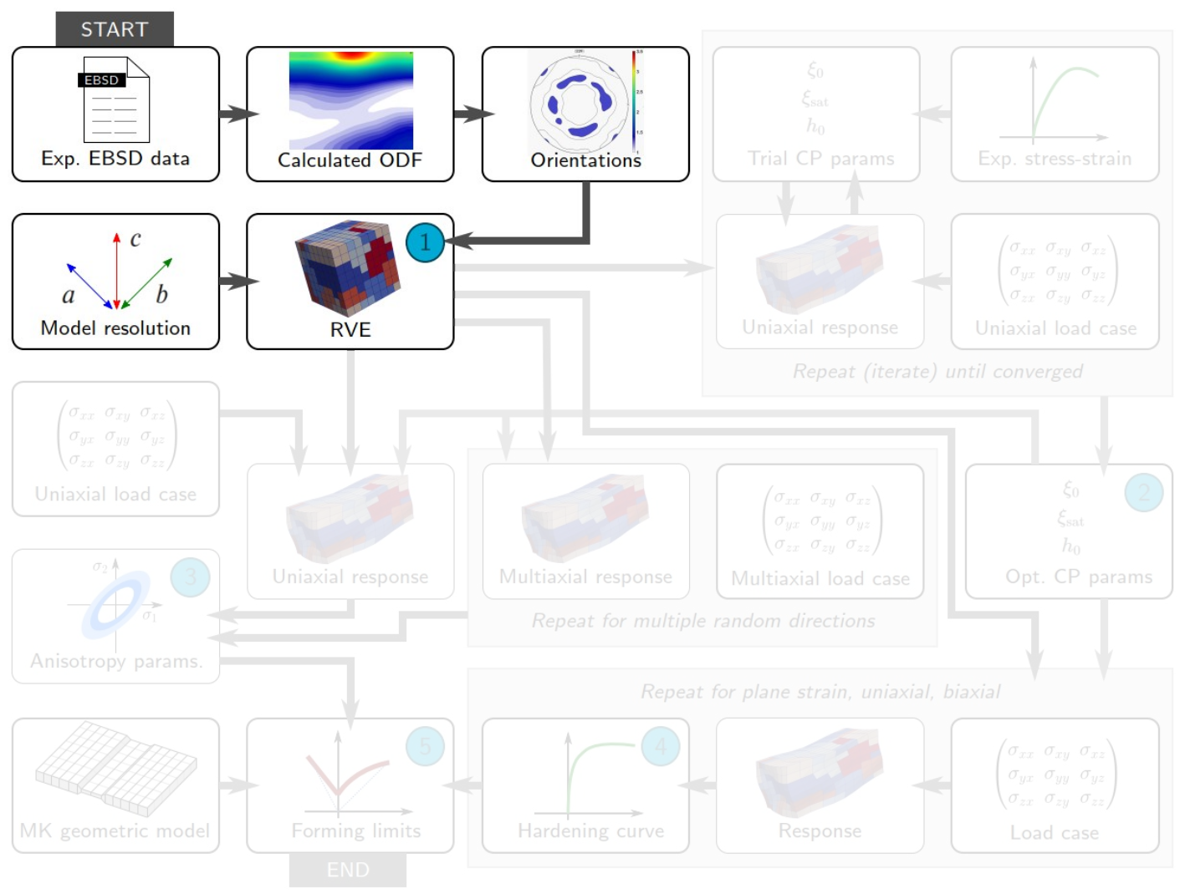
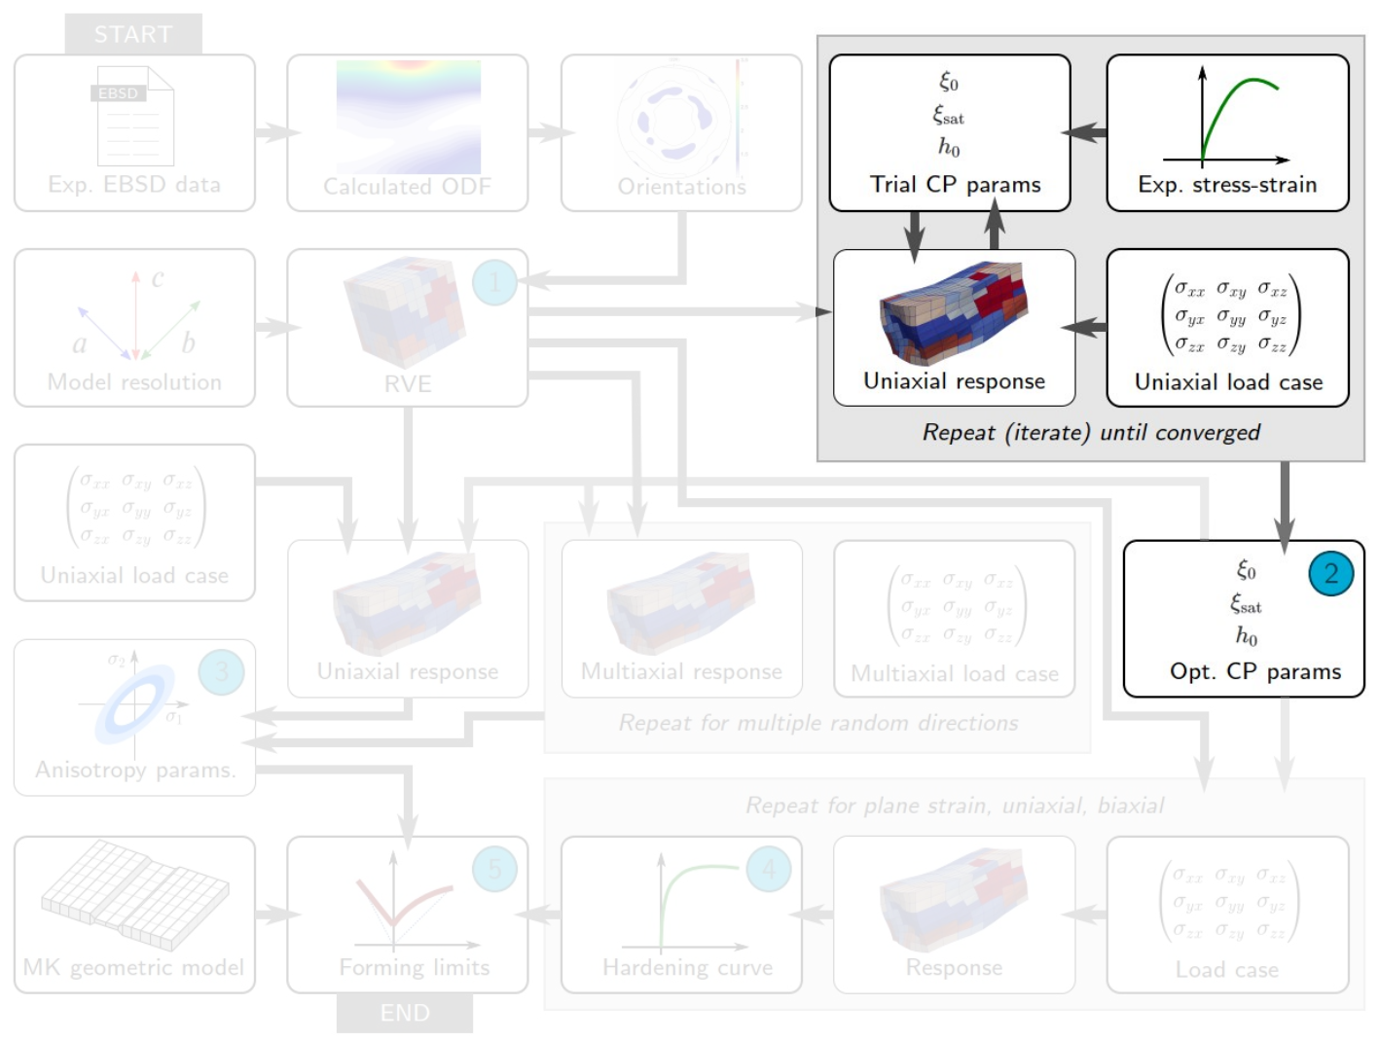
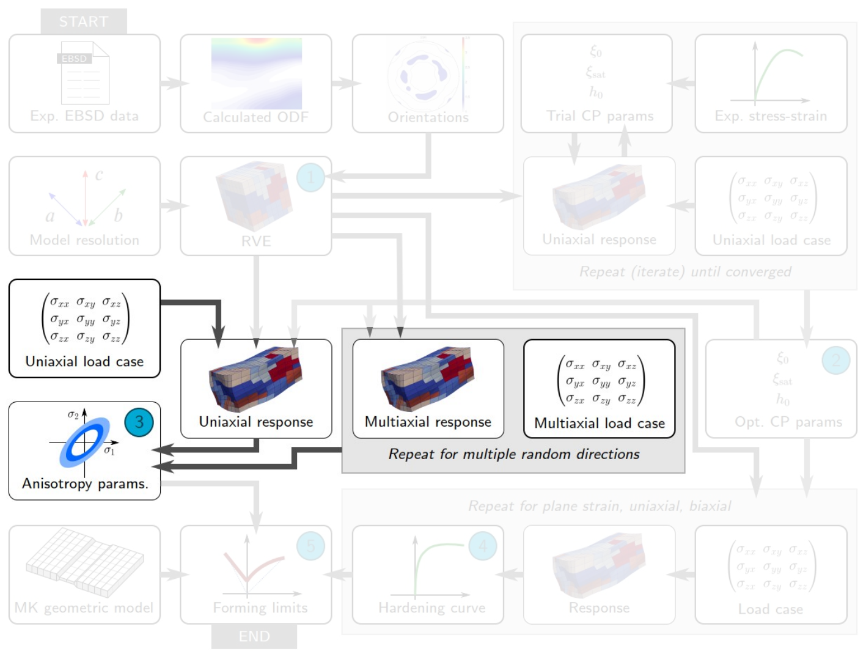
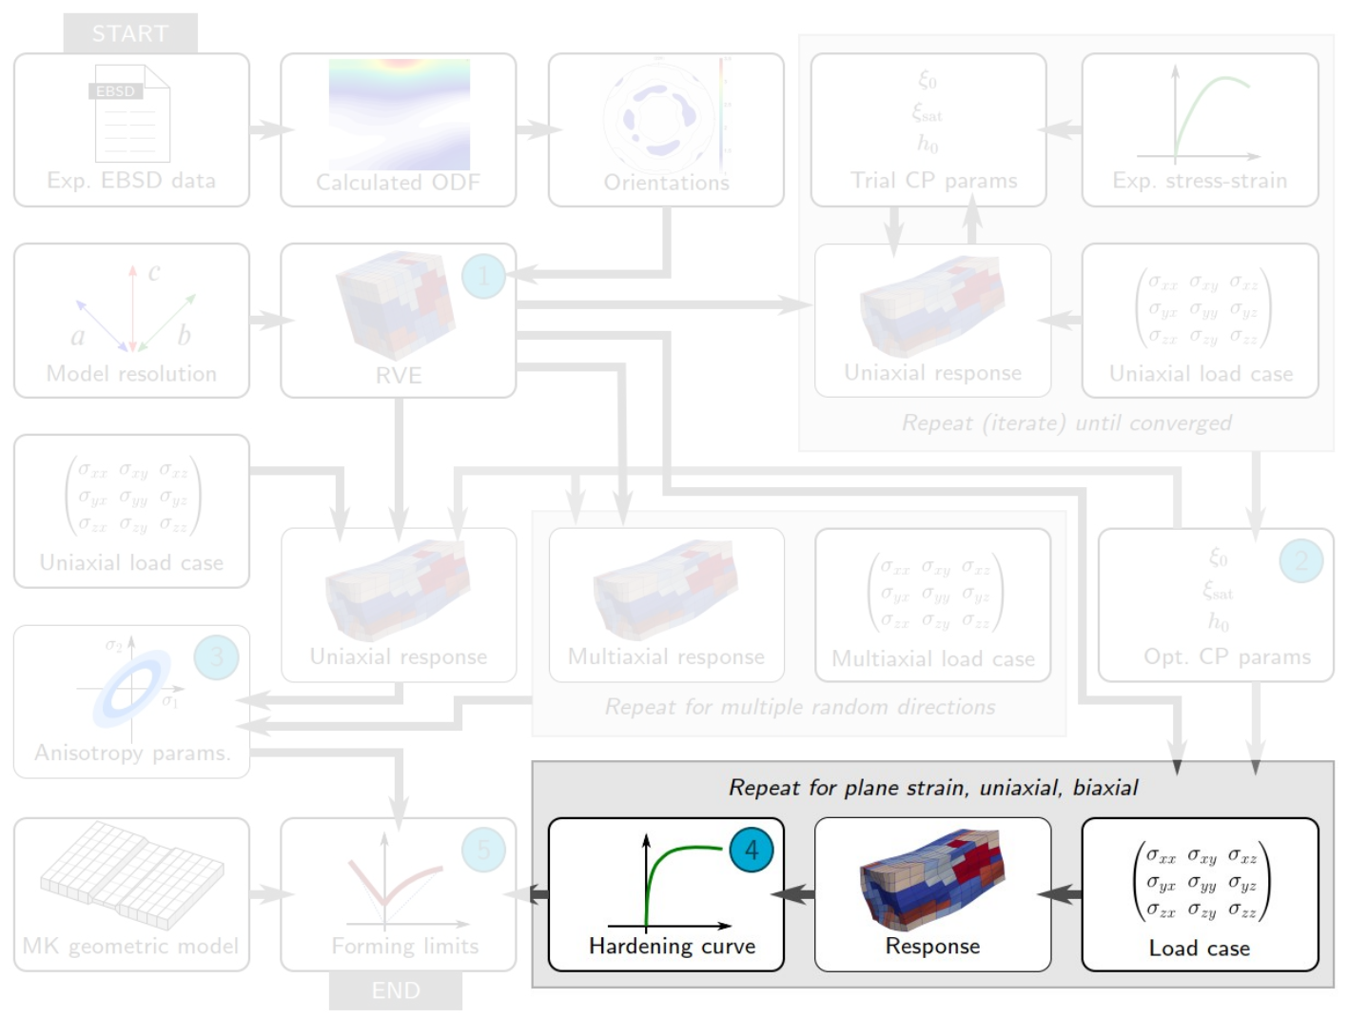
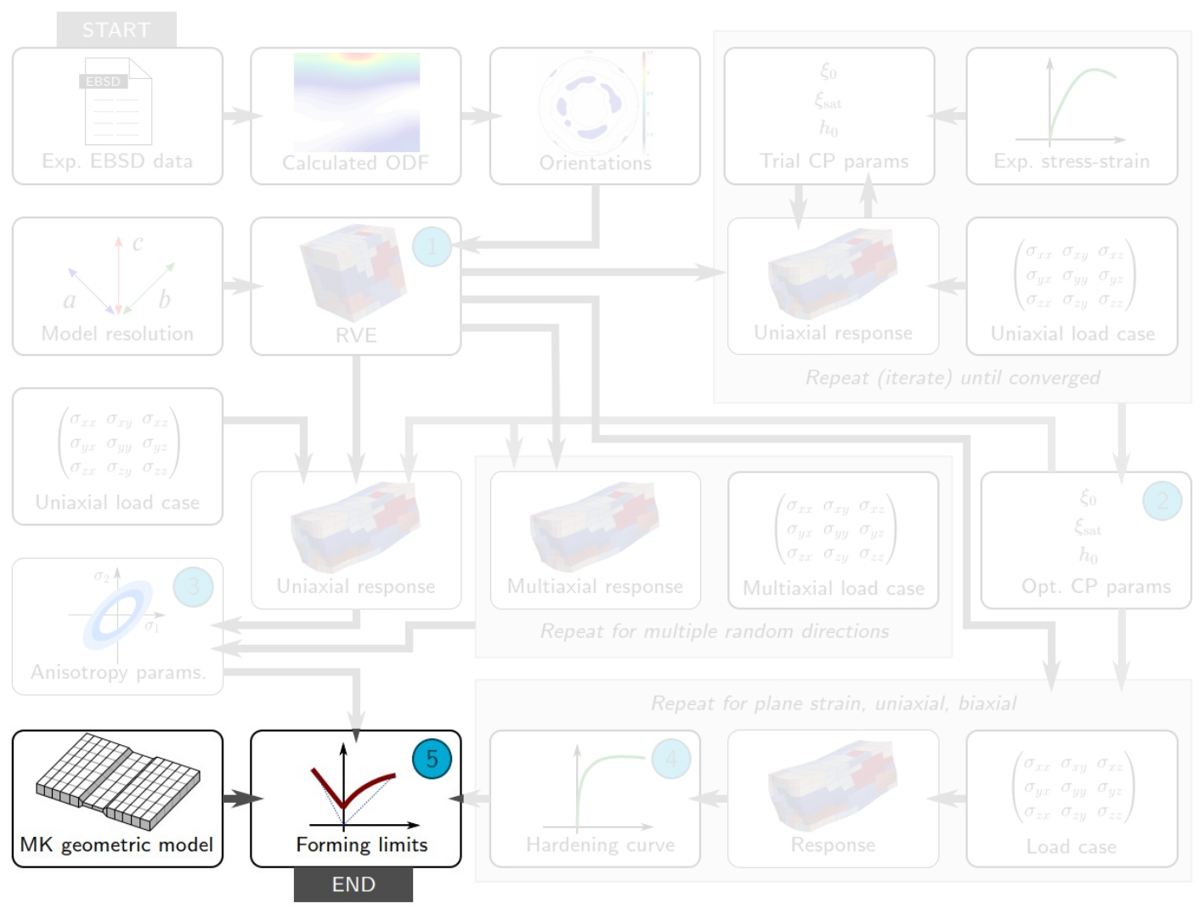
Background
The formability workflow brings together disparate software/data
Sub-workflows:
Generate RVE
Optimise crystal plasticity parameters
Fit yield function
Simulate hardening curves
Predict forming limit strains
Data of a virtual materials test

Slide 5
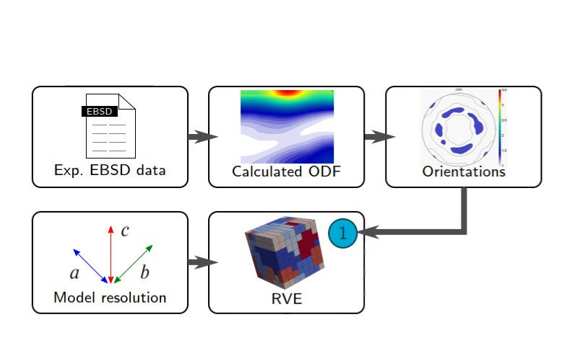
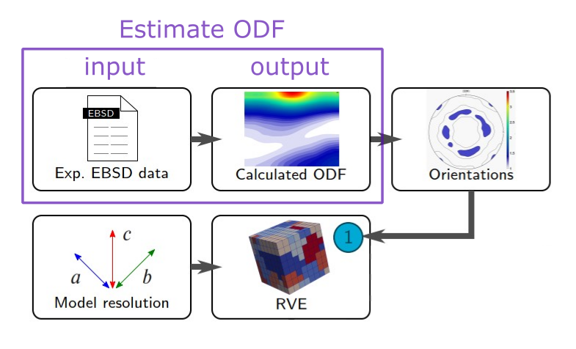
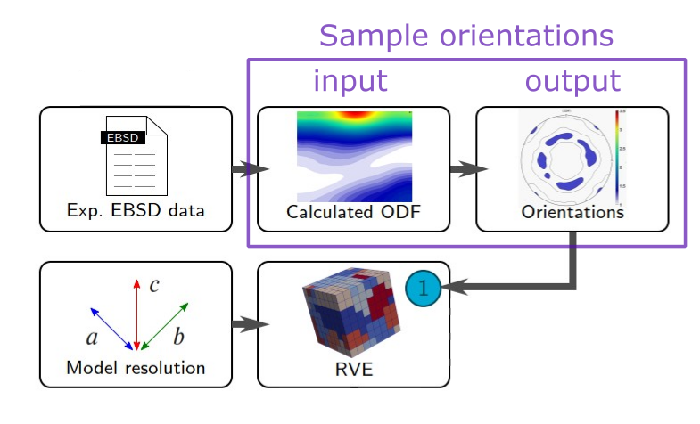
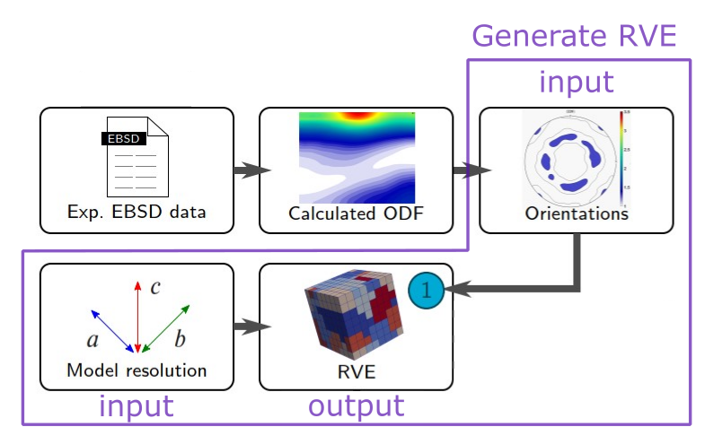
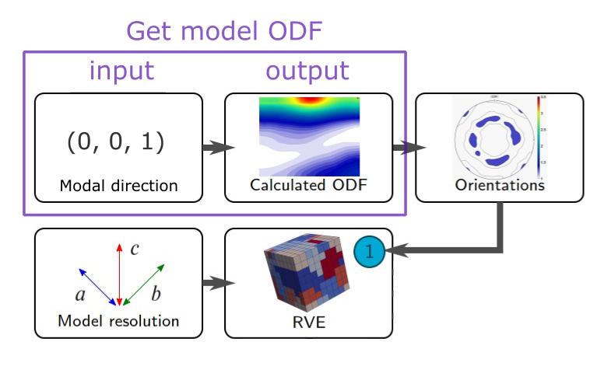
How we use MTEX
Generating representative volume elements
do what?
with which method?
with which software?
Task 1: estimate ODF from CTF file using MTEX
EBSD data ➔ ODF
Task 1: estimate ODF
EBSD data ➔ ODF
Task 2: sample orientations
ODF ➔ orientations
Task 3: generate volume element
orientations, model resolution ➔ volume element
OR:
Task 1: get model ODF
modal direction ➔ ODF

Slide 6
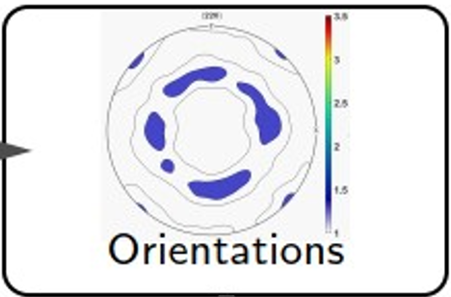
Meta-programming with MTEX
Script generation is one way that MatFlow implements tasks
Meta-programming == code that writes code
MatFlow MTEX extension includes small snippets (.m files)
Given a MatFlow task that uses MTEX, MatFlow combines several snippets together to form a full script
User specifies MatFlow task
MatFlow combines MTEX snippets
MatFlow executes script as part of workflow
name: sample_texture
method: from_model_ODF
software: MTEX
base:
num_orientations: 1000
crystal_symmetry: hexagonal
specimen_symmetry: orthorhombic
ODF_components:
- type: unimodal
component_fraction: 0.7
modal_orientation_HKL: [0, 0, 1]
modal_orientation_UVW: [1, 0, 0]
halfwidth: 5
- type: uniform
component_fraction: 0.3
get_model_ODF.m
main.m
sample_ODF_orientations.m
export_orientations_JSON.m
(used in later tasks)

Slide 7
Challenges/Thanks!
Or learning experiences?
Coordinate system choices!
Problems with compiled MTEX scripts:
Long execution time for MTEX scripts (minutes instead of seconds)
Random seeds seem to be fixed: ask for 10 random orientations => always get the same 10!
Problems with ODF lossless ASCI import/export
Halfwidth does not seem to be preserved on import?
Previously had two separate tasks: generate ODF parameter, sample orientation from ODF parameter
To work around, now one task (ODF is not a MatFlow parameter, exists transiently in MTEX script)
Links:
MatFlow core on GitHub: https://github.com/LightForm-group/matflow
MatFlow MTEX extension on GitHub: https://github.com/LightForm-group/matflow-mtex
Example MatFlow tasks that use MTEX: https://github.com/LightForm-group/UoM-CSF-matflow/blob/master/task_examples/sample_texture.yml

